Slide 1
Crime/Frequency Across Dallas County
Ellen Hu, Benjamin Podell, Valentina Delia, David Liska, & Haley Holcomb

Slide 2
Project Break Down:
www.dallasopendata.com
“Police Incidents”
Why Crime Data:
Property Owner
Business Investor
Citizen
Why Care:
Areas of Opportunity (resource planning and allocation)
Areas of Concern
Trends and Predictions

Slide 3
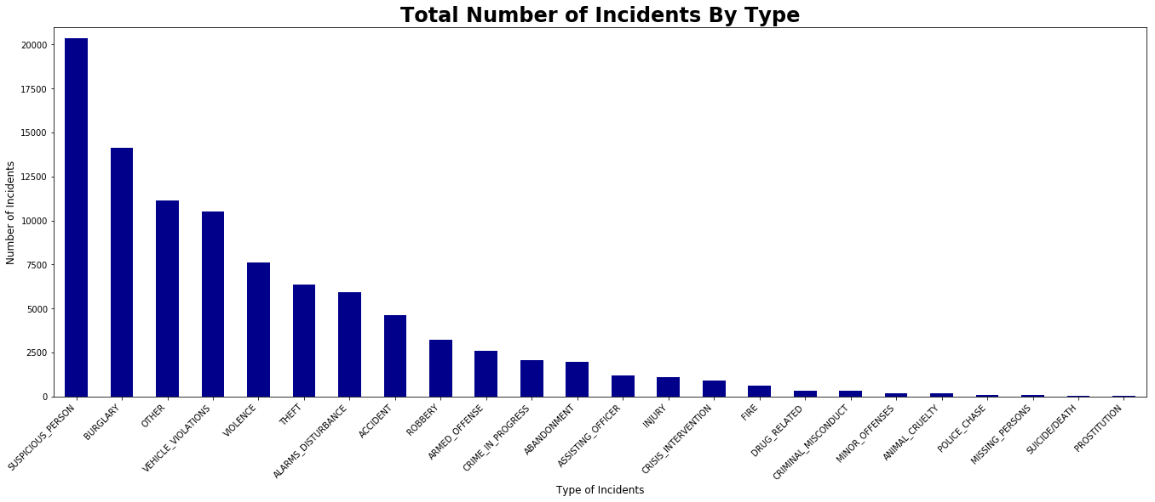
What types of crime are more prevalent within Dallas?
Theory/Fact: Suspicious persons is likely the highest due to the high amount of “civilian” neighbor hood patrols

Slide 4
What different area of Dallas have the highest crime rates, and how does it affect development?

Slide 6
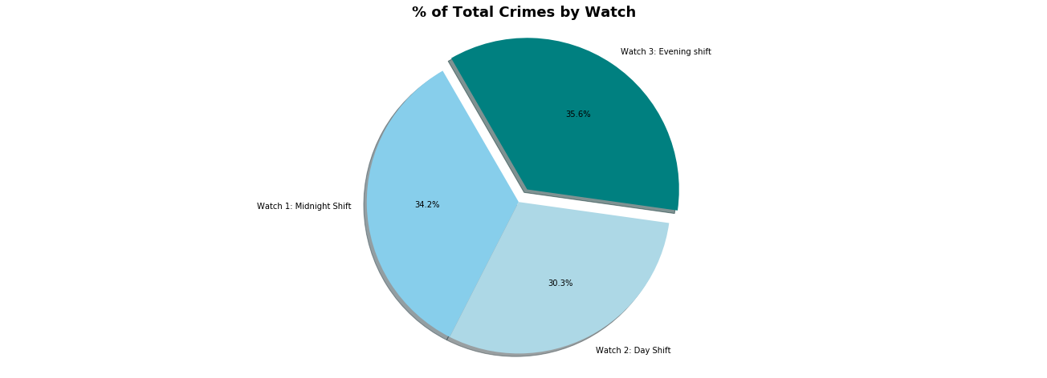
How does time of day, day of the week and month of the year affect the frequency of crime?

Slide 8
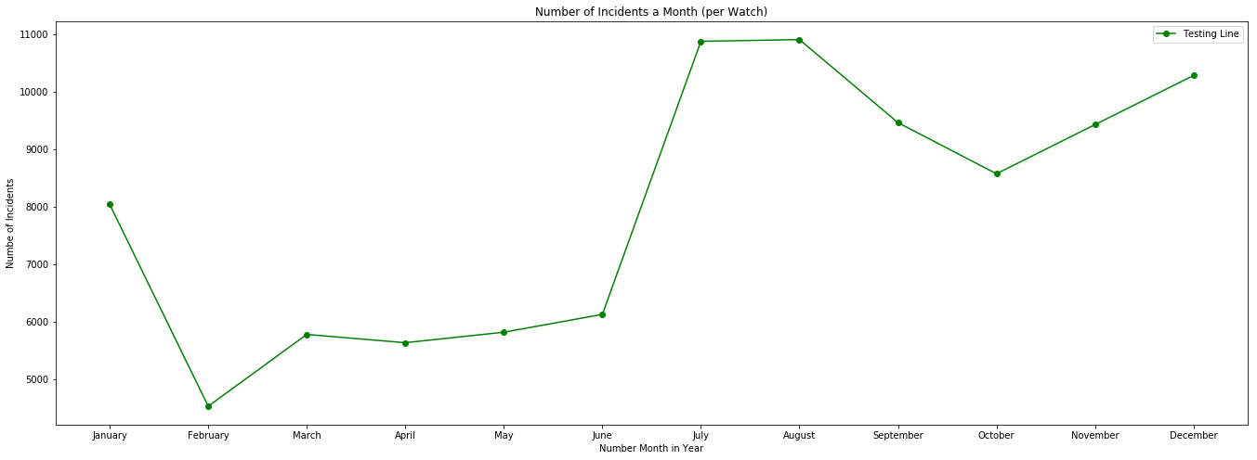
Theory/Fact: Crime spikes to the highest during the hottest months of the year.

Slide 9
Final Thoughts:
Biggest take away: do not rely on the police to get to you quickly in the middle of a crime.
Unless it is a Thursday.
Also, maybe steer clear of cedar crest if looking into property investing in Dallas.

